Slide 1
Tree Diagrams
EQ: How can we show two step problems with tree diagrams?

Slide 2

Topic: EQ:
Tree Diagrams
How can we show two step problems with tree diagrams?
What is Quantitative data?
What is the theoretical probability that I will roll 3 on a dice after 30 rolls?
What is the area of the following shape:
What is $\frac{3}{5}$ as a decimal and a percentage?
$2x−3y+5y−4x=$
10 cm

Slide 3
24
7
30
Topic: Tree Diagrams
Date:
EQ – How can we show two step problems with tree diagrams?
What is a tree diagram?
Tree diagrams are a way of writing the sample space for a particular event.
For a coin toss we can have a heads or a tails. What happens if we toss two coins?

Slide 4
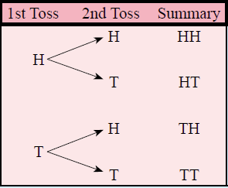

24
7
30
Topic: Tree Diagrams
Date:
EQ – How can we show two step problems with tree diagrams?
What is a tree diagram?
Tree diagrams are another useful way of creating representations of multi step events. Each outcome is represented on a “branch”
For a coin toss we can have a heads or a tails. What happens if we toss two coins?

Slide 5
24
7
30
Topic: Tree Diagrams
Date:
EQ – How can we show two step problems with tree diagrams?
What is a tree diagram?
Tree diagrams are another useful way of creating representations of multi step events. Each outcome is represented on a “branch”
For a coin toss we can have a heads or a tails. What happens if we toss two coins?

Slide 6
24
7
30
Topic: Tree Diagrams
Date:
EQ – How can we show two step problems with tree diagrams?
What is a tree diagram?
Tree diagrams are another useful way of creating representations of multi step events. Each outcome is represented on a “branch”
For a coin toss we can have a heads or a tails. What happens if we toss two coins?
4 outcomes
Heads then Heads = 0.25
Heads then Tails = 0.25
Tails then Heads = 0.25
Tails then Tails = 0.25
What is the probability of getting one of these outcomes?

Slide 7


Slide 8
Activity
You will be given a spot to stand in the room
You need to work out why you are standing there
Notes:
Dark hair, not dark hair
Short hair, long hair
Alternatives: boy / girl, shorts/pants

Slide 9
Short hair
Long hair
5

Slide 10
Light hair
Short and Light hair
Short hair
Dark hair
Short and Dark hair
Light hair
Long and Light hair
Long hair
Dark hair
Long and Dark hair
5

Slide 11
Light hair
Short and Light hair
Short hair
Dark hair
Short and Dark hair
Light hair
Long and Light hair
Long hair
Dark hair
Long and Dark hair
5

Slide 12
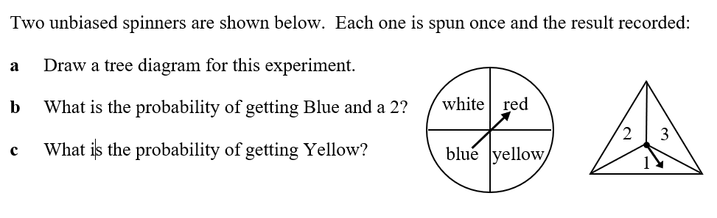

Worked Example
White
Red
Blue
Yellow
1
2
3
1
2
3
1
2
3
1
2
3
W1
W2
W3
R1
R2
R3
B1
B2
B3
Y2
Y2
Y3
$$\frac{1}{12}$$
P (Blue and 2) =
P(Yellow) =
$$\frac{1}{4}$$

Slide 13
